Slide 1
Hibernate Fundamentals
Duong Ly Software Engineer
Oct 2016

Slide 2
Introduction
Your role
Your background and experience in the subject
What do you want from this course

Slide 3
Duration and Course Timetable
Course Duration: 6 hrs

Slide 4
Assessment Disciplines
Class Participation: at least 100% of course time
Final Exam: 70%

Slide 5
Course Administration
In order to complete the course you must:
Sign in the Class Attendance List
Participate in the course
Provide your feedback in the End of Course Evaluation

Slide 6
Course Objectives
At the end of the course, you will have acquired sufficient knowledge to:
Understand the benefits of Hibernate
Understand the Hibernate architecture
Create Hibernate based applications
Understand and use Hibernate mapping to map persistent objects to the database
Understand and work with collections and associations
Map inheritance hierarchies using Hibernate
Work with Hibernate queries, HQL, and Criteria
Performance tune your Hibernate applications
Understand Hibernate transaction support
Use the new Hibernate annotations to do OR mapping
.
Notes:
Understand the benefits of Hibernate
Understand the Hibernate architecture
Create Hibernate based applications
Understand and use Hibernate mapping to map persistent objects to the database
Understand and work with collections and associations
Map inheritance hierarchies using Hibernate
Work with Hibernate queries, HQL, and Criteria
Performance tune your Hibernate applications
Understand Hibernate transaction support
Use the new Hibernate annotations to do OR mapping

Slide 7
Agenda
I. | Introduction to Hibernate | 08
II. | Hibernate architecture | 18
III. | Hibernate Object Relational mapping | 43
IV. | Querying in Hibernate | 61
V. | Hibernate new features | 76
VI. | Hibernate demo | 86
VII. | Hibernate practice | 87
Notes:
7

Slide 8
Course Audience and Prerequisite
Basic understanding of Java
Prior exposure to SQL can be helpful, but its not a pre-requisite for the course

Slide 9
Introduction to Hibernate

Slide 10
What and why is Hibernate?
Hibernate ORM (object-relational mapping ) is an object-relational mapping framework for the Java language. It provides a framework for mapping an object-oriented domain model to a relational database. Hibernate solves object-relational impedance mismatch problems by replacing direct, persistent database accesses with high-level object handling functions.
Hibernate is database independent
Object-relational mapping, you will map a database table with java object called "Entity".
Caching mechanism
Supports Lazy loading
Notes:
You can work with any database you want like oracle,mysql,db2,sql server ,etc. Using hibernate you won't worry about writing database specific queries and syntax. It's provides HQL (Hibernate Query Language), which is compatible with any database server. You just need to write queries in HQL, at the end hibernate converts HQL to underlying database and executes it.
In ORM, you will map a database table with java object called "Entity". So once you map these ,you will get advantages of OOP concepts like inheritance, encapsulation, etc.
Caching mechanism (1st level & 2nd level cache) provided hibernate means you don't need to hit database for similar queries, you can cache it and use it from buffered memory to improve performance. Supports Lazy loading (also called n+1 problem in Hibernate). Take an example-parent class has n number of child class. So When you want information from only 1 child class,there is no meaning of loading n child classes.This is called lazy loading (Load only thing which you want).

Slide 11
Programming relate to relational database
What do relational DBs do well?
Work with large amount of data
Searching, sorting
Work with sets of data
Joining, aggregating
Sharing
Concurrency (Transactions)
Integrity
Constrains
Notes:
The JDBC API is consistent with the style of the core Java interfaces and classes, such as java.lang and java.awt. The following table describes the interfaces, classes, and exceptions (classes thrown as exceptions) that make up the JDBC API
Begin: Most of application connect to database

Slide 12
Programming relate to relational database
What do relational DBs do badly?
Modeling
No polymorphism/inheritance
No support for automatic conversion to objects
Business logic
There ‘s stored procedures, but:
Very database specific
Very coupled with data, really belongs in the application domain
Notes:
Java persistence could be defined as storing Java objects to relational database
Storing Java objects is a natural and common approach to persisting data from Java.
http://en.wikibooks.org/wiki/Java_Persistence/What_is_Java_persistence%3F
EJB and Hibernate implement persistence by mapping java object and database table
Basic Steps to JDBC Operations
1. Load driver or obtain datasource
2. Establish connection using a JDBC URL
3.Create statement
4. Execute statement
5. Optionally, process results in result set
6. Close database resources
7. Optionally, commit/rollback transaction
How to load a Manufacturer that has a list of products
Persistent: Map java objects with database table and make it state (data) synchronous with database

Slide 13
Java Persistence
Storing Java objects to relational databases
Persistent classes:
Persistent classes are classes in an application that implement the entities of the business problem (ex: Customer, Product…)
Notes:
Java persistence could be defined as storing Java objects to relational database
Storing Java objects is a natural and common approach to persisting data from Java.
http://en.wikibooks.org/wiki/Java_Persistence/What_is_Java_persistence%3F
EJB and Hibernate implement persistence by mapping java object and database table
Basic Steps to JDBC Operations
1. Load driver or obtain datasource
2. Establish connection using a JDBC URL
3.Create statement
4. Execute statement
5. Optionally, process results in result set
6. Close database resources
7. Optionally, commit/rollback transaction
How to load a Manufacturer that has a list of products
Persistent: Map java objects with database table and make it state (data) synchronous with database

Slide 14
The Hibernate solution
Hibernate is framework for mapping an object-oriented domain model to a relational database
Easy to develop:
Persistent classes (entities) are POJOs
Easy to write and refactor
Can be serialized
Can execute outside the container (Junit)
POJO programming model
Persistent properties are not abstract
Can instantiate POJOs using new()
Session Interface
Session interface is provided for persistence operations
Notes:
serialization is the process of converting a data structure or object state into a format that can be stored (for example, in a file or memory buffer, or transmitted across a network connection link)
Java Abstract classes are used to declare common characteristics of subclasses. An abstract class cannot be instantiated. ➔ It can be new()
Pojo: plain old java object, include properties and their getter/setter method

Slide 15
The Hibernate solution
Convenience:
Truly object-oriented
Inheritance
Polymorphism
Association
Collections API for “many” relationships
Reduce application code.
Improve performance
Notes:
Manufacture has many product
Hibernate implements many sophisticated performance optimizations, such as caching
Hibernate3 uses lazy select fetching for collections
Optimize SQL

Slide 16
Hibernate development history
Hibernate was started in 2001 by Gavin King with colleagues from Cirrus Technologies as an alternative to using EJB2-style entity beans..
In early 2003, the Hibernate development team began Hibernate2 releases, which offered many significant improvements over the first release.
JBoss, Inc. (now part of Red Hat) later hired the lead Hibernate developers in order to further its development.
In 2005, Hibernate version 3.0 was released. Key features included a new Interceptor/Callback architecture, user defined filters, and JDK 5.0 Annotations (Java's metadata feature). As of 2010, Hibernate 3 (version 3.5.0 and up) was a certified implementation of the Java Persistence API 2.0 specification via a wrapper for the Core module which provides conformity with the JSR 317 standard.^{[2]}
Notes:
Hibernate 1.0 2002
Hibernate 2.0 final on 2003-06-10
Hibernate 3.0 final on 2005-03-31
Hibernate 3.6.7 final on 2011-08-17
Hibernate 4.0.0.CR1 on 2011-09-01

Slide 17
Hibernate development history
In Dec 2011, Hibernate Core 4.0.0 Final was released. This includes new features such as multi-tenancy support, introduction of ServiceRegistry (a major change in how Hibernate builds and manages "services"), better session opening from SessionFactory, improved integration via org.hibernate.integrator.spi.Integrator and auto discovery, internationalization support, message codes in logging, and a more distinction between the API, SPI or implementation classes.^{[3]}
In Dec 2012, Hibernate ORM 4.1.9 Final was released.^{[4]}
In Mar 2013, Hibernate ORM 4.2 Final was released.^{[5]}
In Dec 2013, Hibernate ORM 4.3.0 Final was released.^{[6]} It features Java Persistence API 2.1.^{[7]}
In Sep 2015, Hibernate ORM 5.0.2 Final was released. It has improved bootstrapping, hibernate-java8, hibernate-spatial, Karaf support.
Notes:
Hibernate 1.0 2002
Hibernate 2.0 final on 2003-06-10
Hibernate 3.0 final on 2005-03-31
Hibernate 3.6.7 final on 2011-08-17
Hibernate 4.0.0.CR1 on 2011-09-01

Slide 18

Points to remember
Why?
Notes:
Reasons for Hibernates development
• Impedance mismatch
• Failure of EJB 2.x
• Java developers are not database developers
• Performance benefits

Slide 19
Hibernate architecture

Slide 20
Hibernate architecture
Hibernate architecture overview
Hibernate main classes and interface API
Working with Session interface

Slide 21
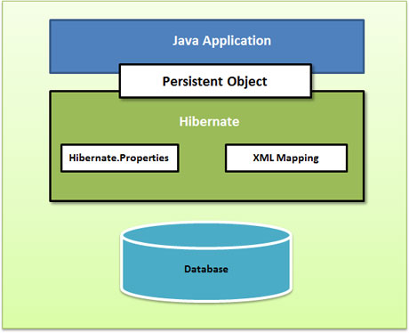
Hibernate architecture overview
High-level view of the Hibernate architecture
Notes:
**Application manipulate with database through Persistent objects
+ A (very) high-level view of the Hibernate architecture. Please refer the diagram above.
+ This diagram shows Hibernate using the database and configuration data to provide persistence services (and persistent objects) to the application.
+ Persistent Objects:
Short-lived, single threaded objects containing persistent state and business function. These might be ordinary JavaBeans/POJOs, the only special thing about them is that they are currently associated with (exactly one) Session
As soon as the Session is closed, they will be detached and free to use in any application layer (e.g. directly as data transfer objects to and from presentation).
To use Hibernate, you are required to create Java classes that represent the table in the database and then map the instance variable in the class with the columns in the database. Now, Hibernate can be used to perform operations on the database such as select, insert, update and delete the records in the table. Hibernate automatically creates the query to perform these operations

Slide 22
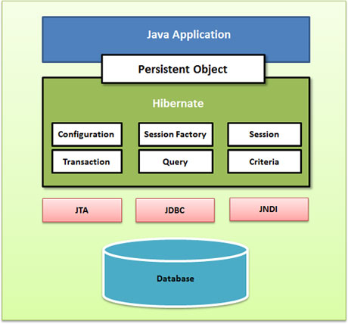
Hibernate architecture overview
Hibernate abstracts the application away from the underlying JDBC/JTA APIs and allows Hibernate to manage the details
Notes:
Hibernate uses various existing Java APIs, like:
JDBC
JDBC provides a rudimentary level of abstraction of functionality common to relational databases, allowing almost any database with a JDBC driver to be supported by Hibernate
Java Transaction API(JTA) and Java Naming and Directory Interface (JNDI)
JNDI and JTA allow Hibernate to be integrated with J2EE application servers.

Slide 23
Hibernate architecture overview
Hibernate architecture has three main components:
Connection Management
Provides efficient management of the database connections.
Transaction management
Provides the ability to the user to execute more than one database statements at a time.
Object relational mapping
Is a technique of mapping the data representation from an object model to a relational data model.
Notes:
The Hibernate architecture is layered so you do not have to know the underlying APIs
Connection Management
Hibernate Connection management service provides efficient management of the database connections. Database connection is the most expensive part of interaction with the database as it requires a lot of resources to open and close the database connection.
Transaction management
Transaction management service provides the ability to the user to execute more than one database statements at a time.
Object relational mapping
Object relational mapping is a technique of mapping the data representation from an object model to a relational data model. This part of Hibernate is used to select, insert, update and delete the records from the underlying table. When you pass an object to a Session.save() method, Hibernate reads the state of the variables of that object and executes the necessary query.

Slide 24
Hibernate main classes and interface API
The main Hibernate API are given below:
- org.hibernate.Hibernate - org.hibernate.Criteria
- org.hibernate.cfg.Configuration - org.hibernate.ScrollableResults
- org.hibernate.SessionFactory - org.hibernate.expression.Expression
- org.hibernate.Session - org.hibernate.Query
- org.hibernate.Transaction - org.hibernate.expression.Order
Notes:
Hibernate (class): Provides access to the full range of Hibernate built-in types
Hibernate.BOOLEAN;
Hibernate.DATE;
Hibernate.CALENDAR;

Slide 25
Hibernate main classes and interface API
Configuration
Reads and establishes the properties that Hibernate uses to connect to a database and configure itself for work.
Database Connection
Class Mapping Setup
Used to create a SessionFactory and then is typically discarded.
SessionFactory
The SessionFactory object is a factory for Session objects and is an expensive object to create.
It is usually created once during application start up like the Configuration object and retained for later use
Session
Provides the main interface to accomplish work with the database.
A Session object is lightweight and inexpensive to create
A Session object establishes a physical connection to the database.
Notes:
Database Connection: This is handled through one or more configuration files supported by Hibernate. These files are hibernate.properties and hibernate.cfg.xml.
Class Mapping Setup This component creates the connection between the Java classes and database tables.

Slide 26
Hibernate main classes and interface API
Transaction
The Hibernate Transaction object absolves the developer from having to deal with the underlying transaction manager/transaction.
Query and Criteria
Query and Criteria objects are used to retrieve (and recreate) persistent objects

Slide 27
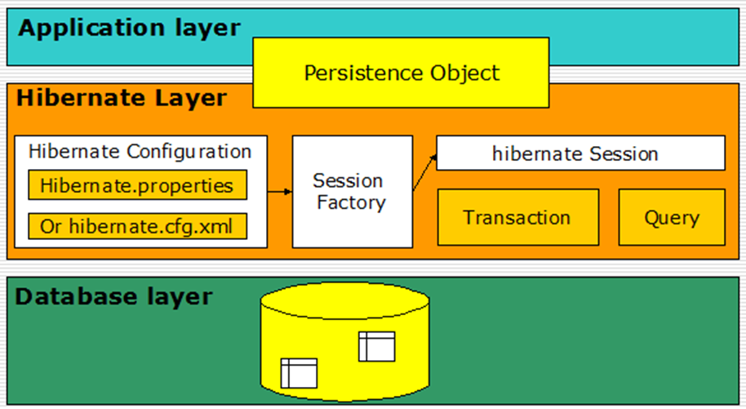
Hibernate main classes and interface API
Classes and interfaces illustrations

Slide 28
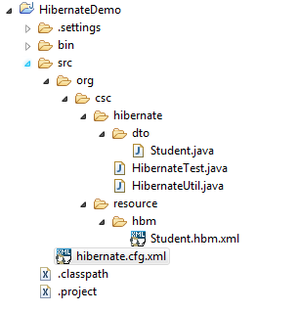
Hibernate main classes and interface API
Structure:

Slide 29
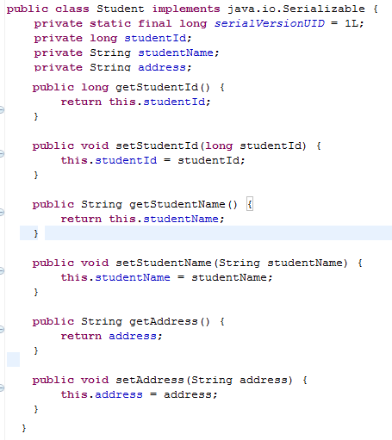
Hibernate main classes and interface API
Step 1: Create a POJO with the name Student
Notes:
package org.csc.hibernate.dto;
public class Student implements java.io.Serializable {
/**
*
*/
private static final long serialVersionUID = 1L;
private long studentId;
private String studentName;
private String address;
public long getStudentId() {
return studentId;
}
public void setStudentId(long studentId) {
this.studentId = studentId;
}
public String getStudentName() {
return studentName;
}
public void setStudentName(String studentName) {
this.studentName = studentName;
}
public String getAddress() {
return address;
}
public void setAddress(String address) {
this.address = address;
}
}

Slide 30
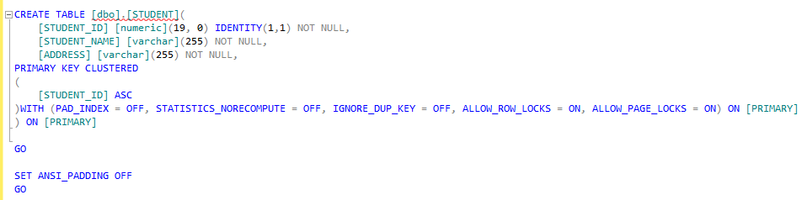
Hibernate main classes and interface API
Step 2: Create a table in SQL database with the name Student
Notes:
CREATE TABLE [dbo].[STUDENT](
[STUDENT_ID] [numeric](19, 0) IDENTITY(1,1) NOT NULL,
[STUDENT_NAME] [varchar](255) NOT NULL,
[ADDRESS] [varchar](255) NOT NULL,
PRIMARY KEY CLUSTERED
(
[STUDENT_ID] ASC
)WITH (PAD_INDEX = OFF, STATISTICS_NORECOMPUTE = OFF, IGNORE_DUP_KEY = OFF, ALLOW_ROW_LOCKS = ON, ALLOW_PAGE_LOCKS = ON) ON [PRIMARY]
) ON [PRIMARY]
GO

Slide 31
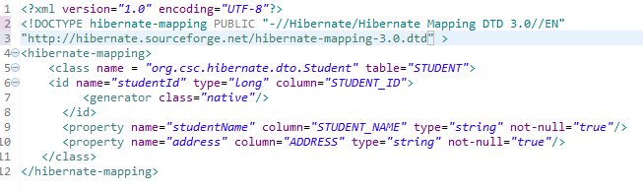
Hibernate main classes and interface API
Step 3: Map the Student object to the database Student table by creating Student.hbm.xml file
Notes:
<?xml version="1.0" encoding="UTF-8"?>
<!DOCTYPE hibernate-mapping PUBLIC "-//Hibernate/Hibernate Mapping DTD 3.0//EN" "http://hibernate.sourceforge.net/hibernate-mapping-3.0.dtd" >
<hibernate-mapping>
<class name = "org.csc.hibernate.dto.Student" table="STUDENT">
<id name="studentId" type="long" column="STUDENT_ID">
<generator class="native"/>
</id>
<property name="studentName" column="STUDENT_NAME" type="string" not-null="true"/>
<property name="address" column="ADDRESS" type="string" not-null="true"/>
</class>
</hibernate-mapping>

Slide 32
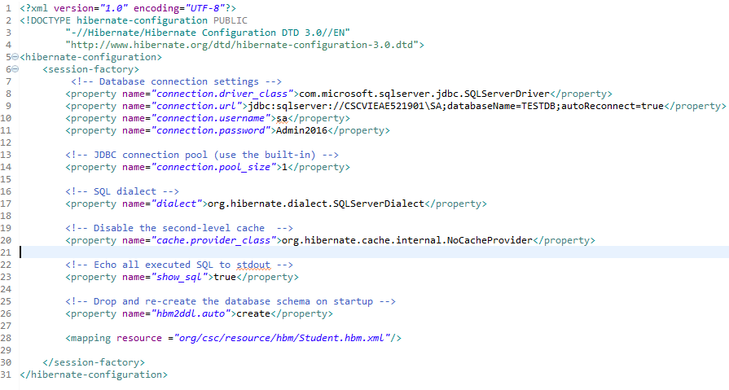
Hibernate main classes and interface API
Step 4: Create Hibernate configuration file (hibernate.cfg.xml)
Notes:
SQL Dialect:
MySQL org.hibernate.dialect.MySQLDialect
Oracle 9i org.hibernate.dialect.Oracle9iDialect
Microsoft SQL Server org.hibernate.dialect.SQLServerDialect
org.hibernate.dialect.Dialect allows Hibernate to generate SQL optimized for a particular relational database.
format_sql: Pretty print the SQL in the log and console. e.g.true | false
release_mode: Specifies when Hibernate should release JDBC connections. By default, a JDBC connection is held until the session is explicitly closed or disconnected. For an application server JTA datasource, use after_statement to aggressively release connections after every JDBC call. For a non-JTA connection, it often makes sense to release the connection at the end of each transaction, by using after_transaction. auto will choose after_statement for the JTA and CMT transaction strategies and after_transaction for the JDBC transaction strategy. e.g.auto (default) | on_close | after_transaction | after_statement
max_fecth_depth: Sets a maximum "depth" for the outer join fetch tree for single-ended associations (one-to-one, many-to-one). A 0 disables default outer join fetching. e.g. recommended values between 0 and 3
current_session_context_class: Supply a custom strategy for the scoping of the "current“ session. e.g.jta | thread | managed | custom.Class
1hibernate.dialect : This property makes Hibernate generate the appropriate SQL for the chosen database. 2hibernate.connection.driver_class : The JDBC driver class.
3hibernate.connection.url :The JDBC URL to the database instance.
4hibernate.connection.username :The database username.
5hibernate.connection.password :The database password.
6hibernate.connection.pool_size : Limits the number of connections waiting in the Hibernate database connection pool. 7hibernate.connection.autocommit : Allows autocommit mode to be used for the JDBC connection.
<?xml version="1.0" encoding="UTF-8"?>
<!DOCTYPE hibernate-configuration PUBLIC
"-//Hibernate/Hibernate Configuration DTD 3.0//EN"
"http://www.hibernate.org/dtd/hibernate-configuration-3.0.dtd">
<hibernate-configuration>
<session-factory>
<!-- Database connection settings -->
<property name="connection.driver_class">com.microsoft.sqlserver.jdbc.SQLServerDriver</property>
<property name="connection.url">jdbc:sqlserver://CSCVIEAE521901\SA;databaseName=TESTDB;autoReconnect=true</property>
<property name="connection.username">sa</property>
<property name="connection.password">Admin2016</property>
<!-- JDBC connection pool (use the built-in) -->
<property name="connection.pool_size">1</property>
<!-- SQL dialect -->
<property name="dialect">org.hibernate.dialect.SQLServerDialect</property>
<!-- Disable the second-level cache -->
<property name="cache.provider_class">org.hibernate.cache.internal.NoCacheProvider</property>
<!-- Echo all executed SQL to stdout -->
<property name="show_sql">true</property>
<!-- Drop and re-create the database schema on startup -->
<property name="hbm2ddl.auto">create</property>
<mapping resource ="org/csc/resource/hbm/Student.hbm.xml"/>
</session-factory>
</hibernate-configuration>

Slide 33
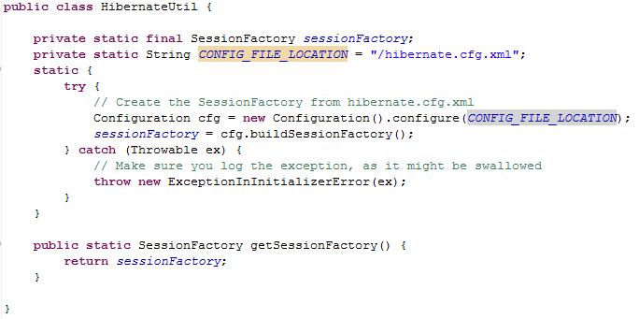
Hibernate main classes and interface API
Step 5: Develop a Hibernate Util class
Notes:
package org.csc.hibernate;
import org.hibernate.SessionFactory;
import org.hibernate.cfg.Configuration;
public class HibernateUtil {
private static final SessionFactory sessionFactory;
private static String CONFIG_FILE_LOCATION = "/hibernate.cfg.xml";
static {
try{
Configuration cfg = new Configuration().configure(CONFIG_FILE_LOCATION);
sessionFactory = cfg.buildSessionFactory();
}catch(Throwable ex){
throw new ExceptionInInitializerError(ex);
}
}
public static SessionFactory getSessionFactory(){
return sessionFactory;
}
}

Slide 34
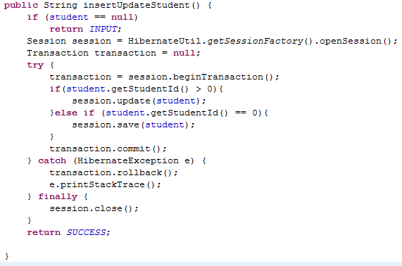
Hibernate main classes and interface API
Step 6: Develop the Insert or update method

Slide 35



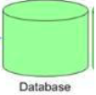

Hibernate main classes and interface API
Flow of Hibernate application

Slide 36
Annotation mappings
Make sure you have Java 5.0 or higher version is installed
Hibernate Core 3.2.0 and above
In addition to the already existing jar files you need to add the following jar files to the classpath
hibernate-commons-annotations.jar
ejb3-persistence.jar
hibernate-annotations.jar

Slide 37
Annotation mappings
Some common annotation attributes
@Entity: Identifies an entity and allows attributes, such as its name, to be overridden from the defaults
@Table : Allows the default details of an entity’s primary table to be overridden.
@Column: Associates a field or property of the class with a column in the mapped table.
@Id: Identifies the primary key of the entity. Placement of the @Id attribute also determines whether the default access mode for the entity class is field or property access.
@GeneratedValue: Allows generation strategies to be specified for the marked entity’s primary key value(s).
@Transient : Allows a field or property to be marked so that it will not be persisted.
@OneToOne : Allows a one-to-one association to be defined between entities.
@OneToMany : Allows a one-to-many association to be defined between entities.
@ManyToMany : Allows a many-to-many association to be defined between entities.
Notes:
Cons of annotations :
- Using annotations immediately restricts your code to a Java 5 environment.
- If you are migrating from a Hibernate 2 environment or an existing Hibernate 3 environment, you will already have XML-based mapping files to support your code base. All else being equal, you will not want to re-express these mappings using annotations just for the sake of it.
- If you are migrating from a legacy environment, you may not want to alter the preexisting POJO source code
Pros of annotations:
- First, and perhaps most persuasively, we find annotations-based mappings to be far more intuitive than their XML-based alternatives, as they are immediately in the source code along with the properties that they are associated with.
- Partly as a result of this, annotations are less verbose than their XML equivalents, as evidenced by the contrast in following table

Slide 38
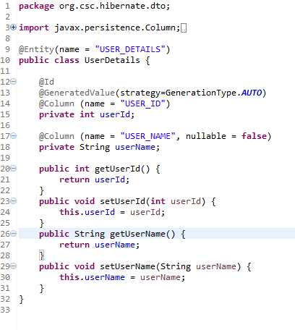
Annotation mappings
Creating the User class with annotations
Notes:
@Entity: annotation marks this class as an entity bean
@Id: Each entity bean has to have a primary key, which you annotate on the class with the @Id annotation. Typically, the primary key will be a single field, though it can also be a composite of multiple fields
Composite Id:
To map a composite key, you can use the EmbeddedId or the IdClass annotations:
With an IdClass
The class for the composite primary key could look like (could be a static inner class):
public class TimePK implements Serializable { protected Integer levelStation; protected String confPathID; public ThePK() {} public ThePK(Integer levelStation, String confPathID) { this.id = levelStation; this.name = confPathID; } // equals, hashCode } And the entity:
@Entity @IdClass(TimePK.class) class Time implements Serializable { @Id private Integer levelStation; @Id private Integer confPathID; private String src; private String dst; private Integer distance; private Integer price; // getters, setters } The IdClass annotation maps multiple fields to the table PK.
=======================================================
With EmbeddedId
The class for the composite primary key could look like (could be a static inner class):
@Embeddable public class TimePK implements Serializable { protected Integer levelStation; protected Integer confPathID; public ThePK() {} public ThePK(Integer levelStation, String confPathID) { this.id = levelStation; this.name = confPathID; } // equals, hashCode } And the entity:
@Entity class Time implements Serializable { @EmbeddedId private TimePK timePK; private String src; private String dst; private Integer distance; private Integer price; //... }
Depending on whether you annotate fields or methods, the access type used by Hibernate will be field or property. The EJB3 spec requires that you declare annotations on the element type that will be accessed, i.e. the getter method if you use property access, the field if you use field access. Mixing annotations in both fields and methods should be avoided. Hibernate will guess the access type from the position of @Id or @EmbeddedId.

Slide 39
Annotation mappings
Creating the User class with annotations
Notes:
@Entity: annotation marks this class as an entity bean
@Id: Each entity bean has to have a primary key, which you annotate on the class with the @Id annotation. Typically, the primary key will be a single field, though it can also be a composite of multiple fields
Composite Id:
To map a composite key, you can use the EmbeddedId or the IdClass annotations:
With an IdClass
The class for the composite primary key could look like (could be a static inner class):
public class TimePK implements Serializable { protected Integer levelStation; protected String confPathID; public ThePK() {} public ThePK(Integer levelStation, String confPathID) { this.id = levelStation; this.name = confPathID; } // equals, hashCode } And the entity:
@Entity @IdClass(TimePK.class) class Time implements Serializable { @Id private Integer levelStation; @Id private Integer confPathID; private String src; private String dst; private Integer distance; private Integer price; // getters, setters } The IdClass annotation maps multiple fields to the table PK.
=======================================================
With EmbeddedId
The class for the composite primary key could look like (could be a static inner class):
@Embeddable public class TimePK implements Serializable { protected Integer levelStation; protected Integer confPathID; public ThePK() {} public ThePK(Integer levelStation, String confPathID) { this.id = levelStation; this.name = confPathID; } // equals, hashCode } And the entity:
@Entity class Time implements Serializable { @EmbeddedId private TimePK timePK; private String src; private String dst; private Integer distance; private Integer price; //... }
Depending on whether you annotate fields or methods, the access type used by Hibernate will be field or property. The EJB3 spec requires that you declare annotations on the element type that will be accessed, i.e. the getter method if you use property access, the field if you use field access. Mixing annotations in both fields and methods should be avoided. Hibernate will guess the access type from the position of @Id or @EmbeddedId.

Slide 40
Working with Session interface
Session is the main runtime interface between a Java application and Hibernate
The main functions of the Session are:
Load instances
Create instances
Update instances
Delete instances
Notes:
Making object persistence:
persist(): makes a transient instance persistent. However, it does not guarantee that the identifier value will be assigned to the persistent instance immediately, the assignment might happen at flush time. The persist() operation on Session is not cascaded at flush time
save() does guarantee to return an identifier
flush(): sometimes the Session will execute the SQL statements needed to synchronize the JDBC connection's state with the state of objects held in memory. This process, called flush, occurs by default at the following points:
before some query executions
from org.hibernate.Transaction.commit()
from Session.flush()
Loading an object:
load() retrieving a persistent instance if you know its identifier. load() takes a class object and loads the state into a newly instantiated instance of that class in a persistent state. Be aware that load() will throw an unrecoverable exception if there is no matching database row
get() : Return the persistent instance of the given entity class with the given identifier, or null if there is no such persistent instance. (If the instance is already associated with the session, return that instance or proxy.)
---------------------------------
saveOrUpdate - This method calls save() or update() based on the operation. If the identifier exists, it will call update method else the save method will be called(if the object is already persistent in this session, do nothing)
connection(): Get the JDBC connection of this Session.
contains(): Check if this instance is associated with this Session
merge(): If there is a persistent instance with the same identifier currently associated with the session, copy the state of the given object onto the persistent instance. If there is no persistent instance currently associated with the session, try to load it from the database, or create a new persistent instance, the persistent instance is returned.
***Use merge() if you want to merge your modifications at any time without consideration of the state of the session
evict(object) Remove this instance from the session cache. Changes to the instance will not be synchronized with the database. This operation cascades to associated instances if the association is mapped with cascade="evict".

Slide 41
Working with Session interface
Some important methods of Session interface:
Method | Description
connection() | Get the JDBC connection of this Session
contains(Object object) | Check if the instance is associated with the Session
merge(Object object) | Copy the state of the given object to the persistent object with the same identifier
save(Object object) | Persist the give transient instance, first assigning generated identifier
update(Object object) | Update the persistent instance with the given detached instance
delete(Object object) | Remove the persistent instance from data store
createSQLQuery(String query) | Create a new instance of SQLQuery for the given SQL query string
disconnect() | Disconnect the Session from the current JDBC connection
getTransaction() | Get the Transaction instance associated with this Session
Notes:
Making object persistence:
persist(): makes a transient instance persistent. However, it does not guarantee that the identifier value will be assigned to the persistent instance immediately, the assignment might happen at flush time. The persist() operation on Session is not cascaded at flush time
save() does guarantee to return an identifier
flush(): sometimes the Session will execute the SQL statements needed to synchronize the JDBC connection's state with the state of objects held in memory. This process, called flush, occurs by default at the following points:
before some query executions
from org.hibernate.Transaction.commit()
from Session.flush()
Loading an object:
load() retrieving a persistent instance if you know its identifier. load() takes a class object and loads the state into a newly instantiated instance of that class in a persistent state. Be aware that load() will throw an unrecoverable exception if there is no matching database row
get() : Return the persistent instance of the given entity class with the given identifier, or null if there is no such persistent instance. (If the instance is already associated with the session, return that instance or proxy.)
---------------------------------
saveOrUpdate - This method calls save() or update() based on the operation. If the identifier exists, it will call update method else the save method will be called(if the object is already persistent in this session, do nothing)
connection(): Get the JDBC connection of this Session.
contains(): Check if this instance is associated with this Session
merge(): If there is a persistent instance with the same identifier currently associated with the session, copy the state of the given object onto the persistent instance. If there is no persistent instance currently associated with the session, try to load it from the database, or create a new persistent instance, the persistent instance is returned.
***Use merge() if you want to merge your modifications at any time without consideration of the state of the session
evict(object) Remove this instance from the session cache. Changes to the instance will not be synchronized with the database. This operation cascades to associated instances if the association is mapped with cascade="evict".
update() if you are sure that the session does not contain an already persistent instance with the same identifier

Slide 42
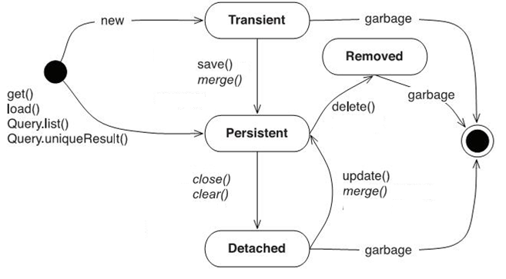
Working with Session interface
Instances may exist in one of three states:
Transient: never persistent, not associated with any Session
Persistent: associated with a unique Session
Detached: previously persistent, not associated with any Session
Notes:
Transient - an object is transient if it has just been instantiated using the new operator, and it is not associated with a Hibernate Session. It has no persistent representation in the database and no identifier value has been assigned. Transient instances will be destroyed by the garbage collector if the application does not hold a reference anymore. Use the Hibernate Session to make an object persistent (and let Hibernate take care of the SQL statements that need to be executed for this transition).
Persistent - a persistent instance has a representation in the database and an identifier value. It might just have been saved or loaded, however, it is by definition in the scope of a Session. Hibernate will detect any changes made to an object in persistent state and synchronize the state with the database when the unit of work completes. Developers do not execute manual UPDATE statements, or DELETE statements when an object should be made transient.
Detached - a detached instance is an object that has been persistent, but its Session has been closed. The reference to the object is still valid, of course, and the detached instance might even be modified in this state. A detached instance can be reattached to a new Session at a later point in time, making it (and all the modifications) persistent again. This feature enables a programming model for long running units of work that require user think-time. We call them application transactions, i.e., a unit of work from the point of view of the user.
close(): End the session by releasing the JDBC connection and cleaning up. It is not strictly necessary to close the session but you must at least disconnect() it.
disconnect(): Disconnect the Session from the current JDBC connection. If the connection was obtained by Hibernate close it and return it to the connection pool; otherwise, return it to the application
clear(): Completely clear the session. Evict all loaded instances and cancel all pending saves, updates and deletions. Do not close open iterators or instances of ScrollableResults.
ScrollableResults interface: Result iterator that allows moving around within the results by arbitrary increments (next, previous, last, first)

Slide 43

Points to remember
Flow of Hibernate application
Hibernate API
Session interface
Instance states

Slide 44
Hibernate Object Relational mapping

Slide 45
Hibernate Object Relational mapping
Why Object Relational Mapping?
Ways to map
Types of mappings
Inheritance
Annotation mappings
Hibernate data types

Slide 46
Why Object Relational Mapping?
Structural mapping more robust
Less error-prone code
Optimized performance all the time
Vendor independence
The mapping document is designed to be readable and hand-editable.
Notes:
data

Slide 47
Ways to map
XML Mappings
The technique that has been available the longest is the use of XML mapping files.
These files can be created directly with a text editor or with the help of various tools created by the Hibernate team and others
Annotation
Hibernate now also supports the Annotations feature introduced in Java 5. This permits the use of a special syntax to include metadata directly in the source code for the application

Slide 48
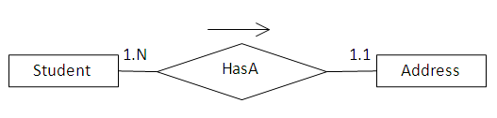
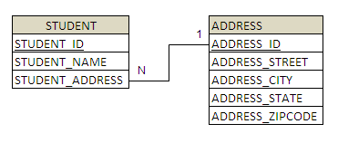
Types of association mappings
Many-to-One Association
Consider the following relationship between Student and Address entity.

Slide 49
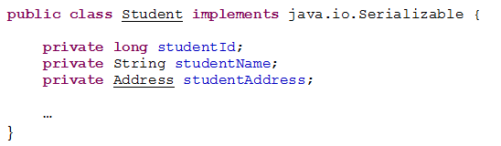
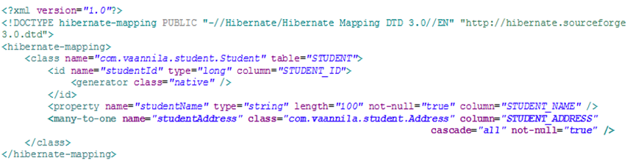
Types of association mappings
Many-to-One Association
Student Java and mapping files:
Notes:
1) cascade="none", the default, tells Hibernate to ignore the association. 2) cascade="save-update" tells Hibernate to navigate the association when the transaction is committed and when an object is passed to save() or update() and save newly instantiated transient instances and persist changes to detached instances.
3) cascade="delete" tells Hibernate to navigate the association and delete persistent instances when an object is passed to delete(). 4) cascade="all" means to cascade both save-update and delete, as well as calls to evict and lock. 5) cascade="all-delete-orphan" means the same as cascade="all" but, in addition, Hibernate deletes any persistent entity instance that has been removed (dereferenced) from the association (for example, from a collection). 6) cascade="delete-orphan" Hibernate will delete any persistent entity instance that has been removed (dereferenced) from the association (for example, from a collection).
Example:
Create one Address instance
Create two Student instances and set Address instance to Student instance
➔ What is the result in database

Slide 50
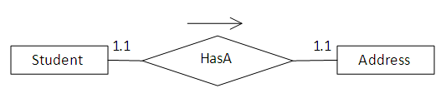
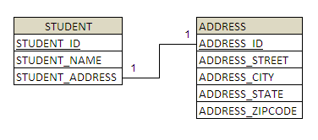
Types of association mappings
One-to-One Association
Consider the following relationship between Student and Address entity

Slide 51
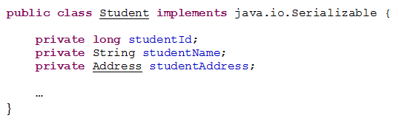
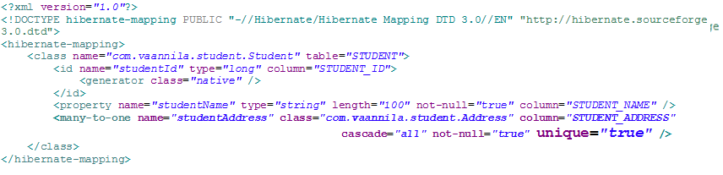
Types of association mappings
One-to-One Association
Student Java and mapping files:
Notes:
Create two Phone
Create two Student
Set Phone to Student
What is the result in database?
A unidirectional one-to-one association on a foreign key is almost identical. The only difference is the column unique constraint.
A unidirectional one-to-one association on a primary key usually uses a special id generator In this example, however, we have reversed the direction of the association:
<class name="Person">
<id name="id" column="personId">
<generator class="native"/>
</id>
</class>
<class name="Address">
<id name="id" column="personId">
<generator class="foreign">
<param name="property">person</param>
</generator>
</id>
<one-to-one name="person" constrained="true"/>
</class>

Slide 52
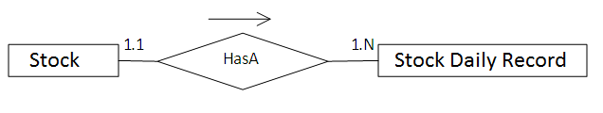
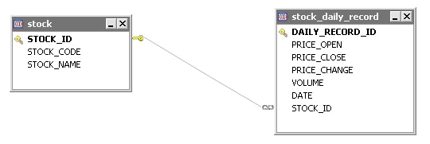
Types of association mappings
One-to-Many Association
Consider the following relationship between Student and Phone entity

Slide 53
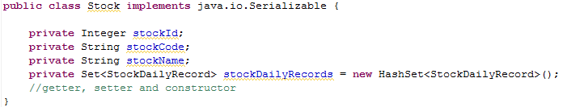
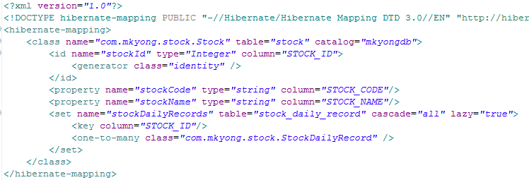
Types of association mappings
One-to-Many Association
Student and Phone Java files:
Notes:
Create a list of Phone
Create a Student
Set phone list to Student
Save Student
What is the result?
lazy=true improves performance: if some class has a bag/set, their elements are loaded only after you make an explicit call to MyObject.mySet

Slide 54
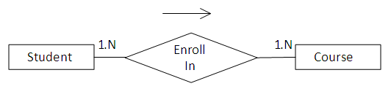
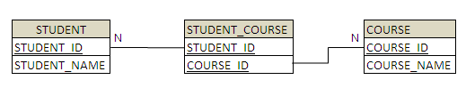
Types of association mappings
Many-to-Many Association
Consider the following relationship between Student and Course entity

Slide 55
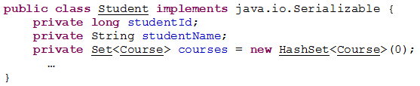
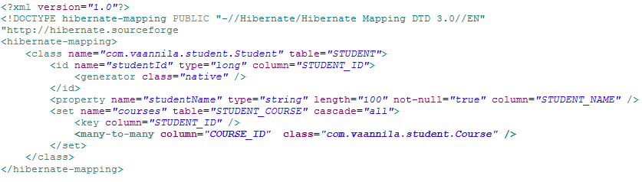
Types of association mappings
Many-to-Many Association
Student and Course Java files:
Notes:
Create a list of Course
Create two Student instances
Set list of Course to Student instances
➔ What is the result?
Courses.size() = 2 (2 course)
Student1,student2, khi save xuong thi 2 student, 2 course va student_course course co rows
Student_id course_id
1
1 2
1
2 2

Slide 56
Inheritance
Hibernate also handles inheritance associations
Three strategies with regard to inheritance mapping
Table per concrete class
Table per subclass
Table per class hierarchy

Slide 57
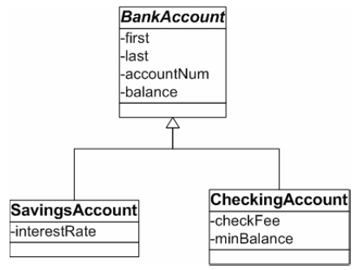



Inheritance
Table per concrete class
Notes:
Concrete class are those classes which can b instantiated unlike Abstract classes which can't be instantiated
<class name="CreditCardPayment" table="CREDIT_PAYMENT">
<id name="id" type="long" column="CREDIT_PAYMENT_ID">
<generator class="native"/>
</id>
<property name="amount" column="CREDIT_AMOUNT"/>
...
</class>
<class name="CashPayment" table="CASH_PAYMENT">
<id name="id" type="long" column="CASH_PAYMENT_ID">
<generator class="native"/>
</id>
<property name="amount" column="CASH_AMOUNT"/>
...
</class>
<class name="ChequePayment" table="CHEQUE_PAYMENT">
<id name="id" type="long" column="CHEQUE_PAYMENT_ID">
<generator class="native"/>
</id>
<property name="amount" column="CHEQUE_AMOUNT"/>
...
</class>

Slide 58
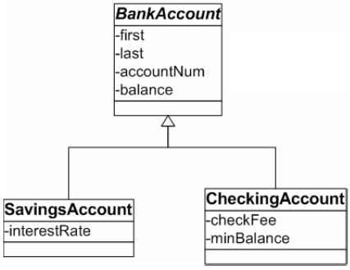





Inheritance
Table per subclass
Notes:
<class name="Payment" table="PAYMENT">
<id name="id" type="long" column="PAYMENT_ID">
<generator class="native"/>
</id>
<property name="amount" column="AMOUNT"/>
...
<joined-subclass name="CreditCardPayment" table="CREDIT_PAYMENT">
<key column="PAYMENT_ID"/>
<property name="creditCardType" column="CCTYPE"/>
...
</joined-subclass>
<joined-subclass name="CashPayment" table="CASH_PAYMENT">
<key column="PAYMENT_ID"/>
...
</joined-subclass>
<joined-subclass name="ChequePayment" table="CHEQUE_PAYMENT">
<key column="PAYMENT_ID"/>
...
</joined-subclass>
</class>

Slide 59
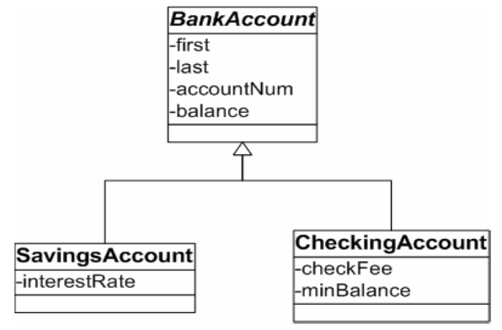


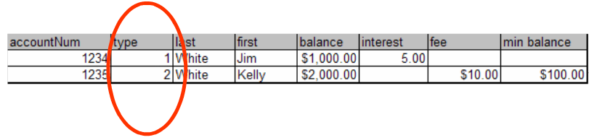
Inheritance
Table per class hierarchy
Notes:
<class name="Payment" table="PAYMENT">
<id name="id" type="long" column="PAYMENT_ID">
<generator class="native"/>
</id>
<discriminator column="PAYMENT_TYPE" type="string"/>
<property name="amount" column="AMOUNT"/>
...
<subclass name="CreditCardPayment" discriminator-value="CREDIT">
<property name="creditCardType" column="CCTYPE"/>
...
</subclass>
<subclass name="CashPayment" discriminator-value="CASH">
...
</subclass>
<subclass name="ChequePayment" discriminator-value="CHEQUE">
...
</subclass>
</class>

Slide 60
Hibernate data types
Support all Java primitives and many JDK classes.
Hibernate supports user-defined custom types.
int, long, String, java.io.Serialize, java.util.Calendar,….. (Java Types)
Collection, List, ArrayList,…. (Java Collection)
Personel, PlayerInfo,…. (Custom Types)

Slide 61
- Ways of mappings
- Types of mappings
- Inheritance

Slide 62
Querying in Hibernate

Slide 63
Querying in Hibernate
Hibernate Query Language
The Criteria Query API
Native SQL

Slide 64
Hibernate Query Language
Make SQL be object oriented
Classes and properties instead of tables and columns
Polymorphism
Associations
Much less verbose than SQL
Full support for relational operations
Inner/outer/full joins
Projection
Aggregation (max, avg) and grouping
Ordering
Subqueries
SQL functions calls
Database independent
Queries written in HQL are database independent
Notes:
Full support for relational operations:
HQL allows representing SQL queries in the form of objects. HQL uses Classes and properties instead of tables and columns.
Return result as Object:
This eliminates the need of creating the object and populates the data from result set.
Polymorphic Queries:
HQL fully supports polymorphic queries. Polymorphic queries results in the query along with all the child objects if any.
Easy to Learn:
Hibernate Queries are easy to learn and can be easily implemented in the applications.
Support for Advance features:
HQL contains many advanced features such as pagination, fetch join with dynamic profiling, Inner/outer/full joins, Cartesian products. It also supports Projection, Aggregation (max, avg) and grouping, Ordering, Sub queries and SQL function calls.
Database independent:
Queries written in HQL are database independent

Slide 65

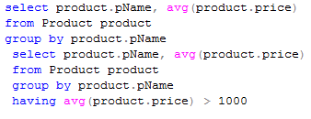
Hibernate Query Language
Support: Select, From, Where, Order by, Group by and Having clause
Simple query
Aggregation query
Notes:
No select *

Slide 66

Hibernate Query Language
Paging Through the Result Set
setFirstResult(): set the first row to retrieve
setMaxResults(): set the maximum number of rows to retrieve

Slide 67
Hibernate Query Language
Associations and joins
Allows to use more than one class in HQL query
inner join
cross join
left outer join
right outer join
Full join (not usually useful)
Aggregate functions
They work the same way in HQL as they do in SQL
avg(…)
sum(…)
min(…)
max(…)
count(*)
count(…)
count(distinct…)
count(all…)

Slide 68
Hibernate Query Language
Expressions
Allowed in the where clause include most of the operations that you could perform in SQL:
Mathematical operators +, -, *, /
Binary comparison operators =, >=, <=, <>, !=, like
Logical operations and, or, not
String concatenation ||
SQL scalar functions such as upper() and lower()
Parentheses ( ) indicate grouping
in, between, is null
JDBC IN parameters ?
named parameters :name, :start_date, :x1

Slide 69


Hibernate Query Language
Bulk Updates and Deletes:
Bulk Updates:
Bulk Deletes:

Slide 70

The Criteria Query API
Provides way of generating queries through method calls
Provide a compile-time syntax-checking that is not possible with a query language
Lets you build nested, structured query expressions in Java
The Criteria API also includes query by example (QBE) functionality
Criteria Query example:

Slide 71

The Criteria Query API
Using the Restrictions
eq(…): Apply an "equal" constraint to the named property
ge(…) : Apply a "greater than or equal" constraint to the named property
gt(…): Apply a "greater than" constraint to the named property
like(…): Apply a "like" constraint to the named property
ne(…): Apply a "not equal" constraint to the named property
and(…): Return the conjunction of two expressions
or(…): Return the disjunction of two expressions
Criteria AND:
Criteria OR:

Slide 72



The Criteria Query API
Paging Through the Result Set
setFirstResult(): takes an integer that represents the first row in your result set
setMaxResults() : set the maximum number of rows to retrieve
Obtaining a Unique Result
Make sure that your query only returns one or zero results if you use the uniqueResult() method. Otherwise, Hibernate will throw an exception
Sorting the Query’s Results

Slide 73

The Criteria Query API
Projections and Aggregates
The row-counting functionality provides a simple example of applying projections.
Other aggregate functions include the following:
avg(String propertyName): Gives the average of a property’s value
count(String propertyName): Counts the number of times a property occurs
countDistinct(String propertyName): Counts the number of unique values the property contains
max(String propertyName): Calculates the maximum value of the property values
min(String propertyName): Calculates the minimum value of the property values
sum(String propertyName): Calculates the sum total of the property values
Notes:
The results list will contain one object, an Integer that contains the results of executing the COUNT SQL statement

Slide 74
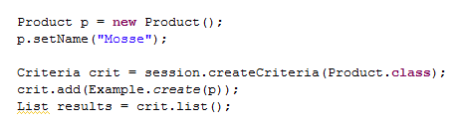
The Criteria Query API
Query by Example (QBE)
Use instance as a template and have Hibernate build the criteria for you based upon its values
All the properties on our Example objects get examined.
The default is to ignore null-valued properties.

Slide 75
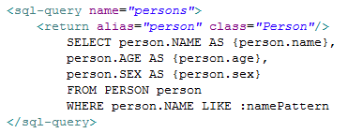

Native SQL
Using a SQLQuery:
These will return a List of Object arrays (Object[]) with scalar values for each column in the Student table.
To get entity objects from a native sql query via addEntity().
Using Named SQL Queries
Named SQL queries can also be defined in the mapping document, in this case, you do not need to call addEntity()
Named sql query using the <sql-query> maping element
Execution of a named query

Slide 76
- How to query in Hibernate?
- How to page through the result set?

Slide 77
Hibernate new features

Slide 78
Hibernate New Features
Data Filtering
Interceptors
Calling Triggers and Stored Procedures

Slide 79
Data Filtering
Limit the amount of data visible without modifying query parameters
Often used for security purposes
Users often only have access to certain levels of information
Step to set up Data Filters
Define the filter within the mapping file of the targeted entity
Identify the attributes to filter on, and their types
Apply the filter on the desired class or collection by indicating it within the <class> or <collection-type> tags
After obtaining a session with which to perform your actions, enable the appropriate filter, setting any applicable parameters
Notes:
Hibernate filter: is a global, named, parameterized filter that can be enabled or disabled for a particular Hibernate session.
These filter conditions, however, can be parameterized. The application can then decide at runtime whether certain filters should be enabled and what their parameter values should be.

Slide 80
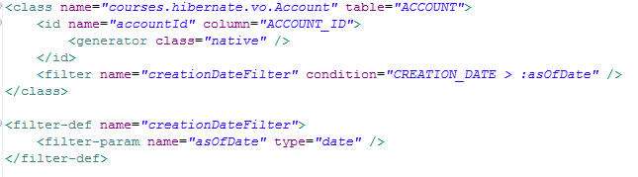
Data Filtering
Account mapping file
Account class filter

Slide 81
Interceptors
Callbacks from the session allowing the application to inspect and/or manipulate properties of a persistent object
Before it Is saved, updated, deleted or loaded
Implemented one of two ways
Implement Interceptor directly
Extend EmptyInterceptor (preferred)
Comes in two flavors
Session-scoped
Specified when a session is opened
SessionFactory.openSession(Interceptor)
SessionFactory-scoped
Registered on the configuration during factory creation
Applies to all sessions

Slide 82
Interceptors
Creating Interceptor
Extend the EmptyInterceptor class
Implement the desired callback methods
afterTransactionBegin(…)
afterTransactionCompletion (…)
onSave (…)
onDelete(…)
onLoad(…)
etc...
Configure the interceptor use
• Either during factory creation
• After obtaining a session
Notes:
Setting Interceptor
When creating the SessionFactory causes interception on all sessions:
SessionFactory sessionFactory = Configuration().setInterceptor(new AccountDateInterceptor())
.configure().buildSessionFactory();
When opening an individual session:
Session session = HibernateUtil.getSessionFactory().openSession(new AccountDateInterceptor());

Slide 83
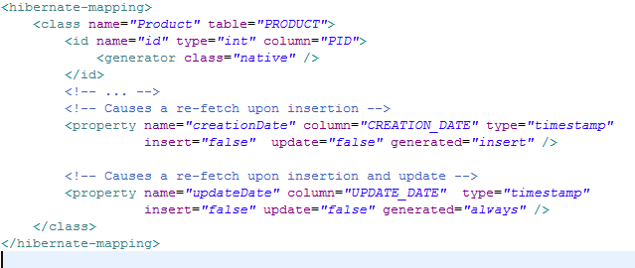
Triggers
Identify columns that are modified automatically by the database in the object mapping file
generated="insert | always“
Also need to tell Hibernate NOT to insert or update these columns, as appropriate
Hibernate will re-read the object as appropriate
For insert, after the insert statement is executed
For always, after insert or update statements
Setting up Triggers
Notes:
update, insert (optional - defaults to true): specifies that the mapped columns should be included in SQL UPDATE and/or INSERT statements. Setting both to false allows a pure "derived" property whose value is initialized from some other property that maps to the same column(s), or by a trigger or other application.
generated (optional - defaults to never): specifies that this property value is actually generated by the database. See the discussion of generated properties for more information.
never (the default): the given property value is not generated within the database.
insert: the given property value is generated on insert, but is not regenerated on subsequent
updates. Properties like created-date fall into this category. Even though version and timestamp properties can be marked as generated, this option is not available.
always: the property value is generated both on insert and on update.
Default: allow hibernate to insert value from object to column (update, insert default to true).
When we want database insert value to table columns by database, we use triggers
Generated: insert =>trigger of database insert data to that column when inserting
Genernated: always=>trigger of database insert data to that column when inserting or updating
And then data will be re-read to object

Slide 84
Stored Procedures
Calling Stored Procedures
For querying, similar syntax and process as named sql-query
Defined inside or outside the class tags in the mapping file
If returning a value, can set an alias and return type
For insert, update, or delete, must be defined inside the class tag
Must set the ‘callable’ attribute

Slide 85
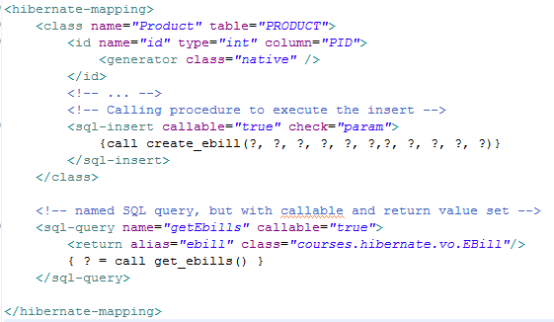
Stored Procedures
Stored Procedures Setup
Notes:
sessionObj = HibernateUtil.currentSession();
String keyWord = paymentMasterSearchValue.getSearchKeyWord();
paymentMasterlist = sessionObj.getNamedQuery("selectPaymentMaster_SP“).setParameter("paymentTypeCode", keyWord)
.setParameter("callingAPI", "OC25“).list();
Stored procedures currently only return scalars and entities. <return-join> and <load-collection> are not supported.
Scarlar: It means a single value as opposed to a set of values. It often means a constant, such as a string or a number. It can also refer to a variable, and I believe a column.

Slide 86
Points to remembers
- Data Filtering
- Interceptors and Events
- Calling Triggers and Stored Procedures
Notes:
Relational Persistence for Java
Hibernate itself takes care of the mapping an object model ‘s data representation to a relational data model.
Transparent Persistence
The automatic mapping of Java objects with database tables and vice versa is called Transparent Persistence.
Support for Query Language
Hibernate provide a powerful query language HQL (independent from type of database).
Database Dependent Code
If there is change in Database or in any table then you only need to change the XML file properties
Maintenance Cost
Hibernate relieves developer from handling with JDBC result set and convert it to Java objects through code to use this persistent data in application.
Optimize Performance
With Transparent Persistence, cache is set to application work space. Relational tuples are move to this cache as a result of query that improves performance if client application reads the same data repeatedly.
Automatic Versioning and Time Stamping
By database versioning one can be assured that the changes done by one person is not being roll backed by another one unintentionally.
So if two users retrieve same tuple and then modify it and one user saves this modified tuple to
database, version is automatically updated for this tuple by Hibernate. When
another user tries to save updated tuple to database then it does not allow to
save it because this user does not have updated data
Open-Source, Zero-Cost Product License
Hibernate is an open source and is free to use for both development and production deployments.
So if two users retrieve same tuple and then modify it and one user saves this modified tuple to
database, version is automatically updated for this tuple by Hibernate. When
another user tries to save updated tuple to database then it does not allow to
save it because this user does not have updated data

Slide 87
Hibernate demo

Slide 88
Hibernate practice

Slide 89
Thank You

Slide 90
Revision History
Date | Version | Description | Updated by | Reviewed and Approved By
01/01/2011 | 1.0 | Initialize | Hien Vo
06/29/2016 | 1.1 | Update Image and template | Lam Tang | Quang Tran

Slide 91


